Slide 1
Exploratory Data Analysis
On
1000 Movie Data
By Abhishek Thakur
Email ID:- abhishekrcks1995@gmail.com

Slide 2
Introduction
Movies are one of the source of Entertainment. Entertainment is major part of our lives where we spend much of our free time to relax & get a break from the everyday schedule.
In the film industry, data analytics is often used to predict box office success. This information can be gathered through pre-release surveys, social media monitoring, and website traffic analysis.

Slide 3
Problem Statement
A company approaches a data scientist and ask him to come up with characteristics of movies that will help them to achieve best revenue and popularity.
They have given the IMDB database of 1000 movies for the last 10 years, That will help them to achieve their purpose .

Slide 4
Installing & Importing Libraries
Numpay
Pandas
Seaborn
matplotlib.pyplot

Slide 5
Data Acquisition & Description
Data Pre-Profiling
Importing IMDB database of 1000 movies data.
Data has 12 columns and 1000 rows
5 categorical variable & 6 continuous variable

Slide 6
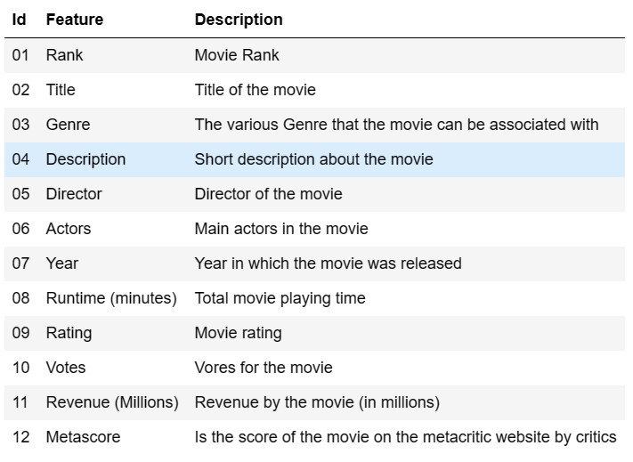
Data Information

Slide 7
Data Pre-Processing
Meta score and Revenue found missing values
No outlier present in Data
Description column has less impact on the out come.

Slide 8
Data Post-Profiling
& EDA
Post-Profiling
Filling missing value in Meta score with Mean
Filling missing value in Revenue with Mean

Slide 9
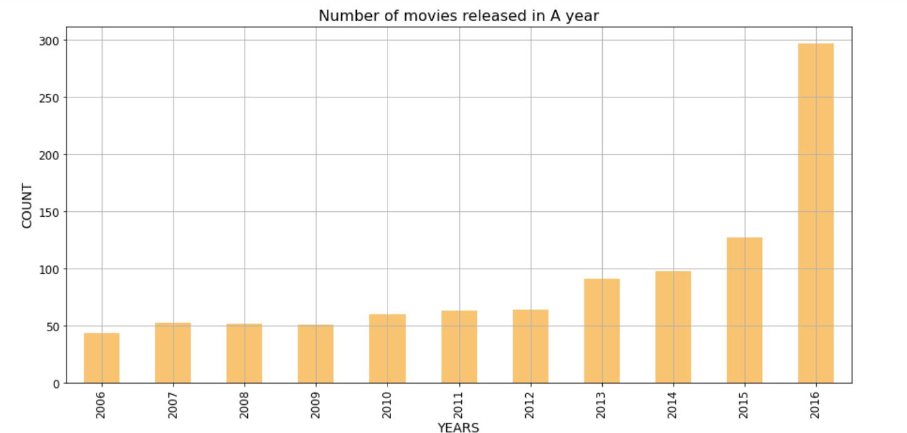
Bar Chart Number of movies released in A year

Slide 10
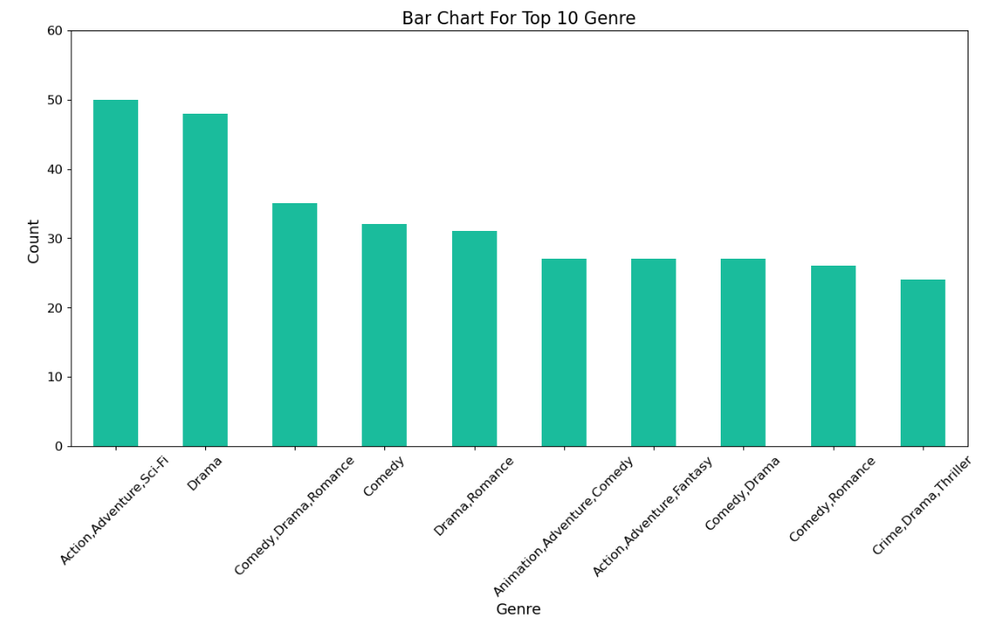
Bar Chart For Top 10 Genre

Slide 11
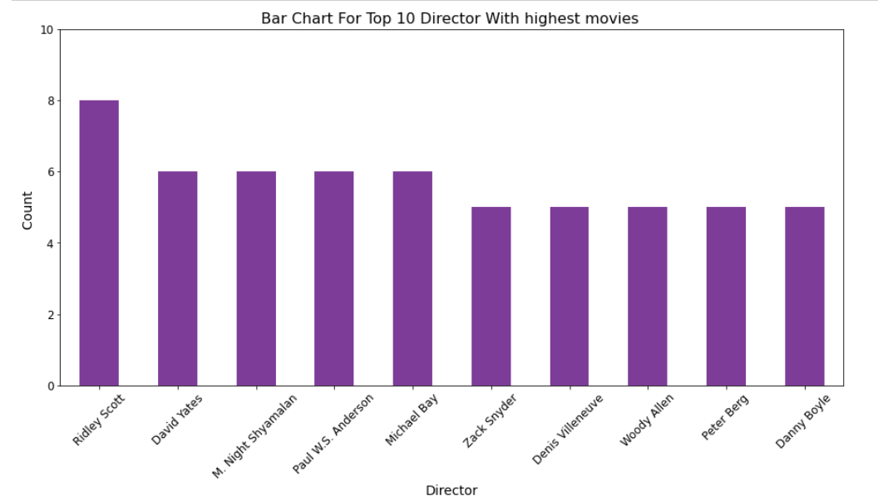
Bar Chart For Top 10 Director With highest movies

Slide 12
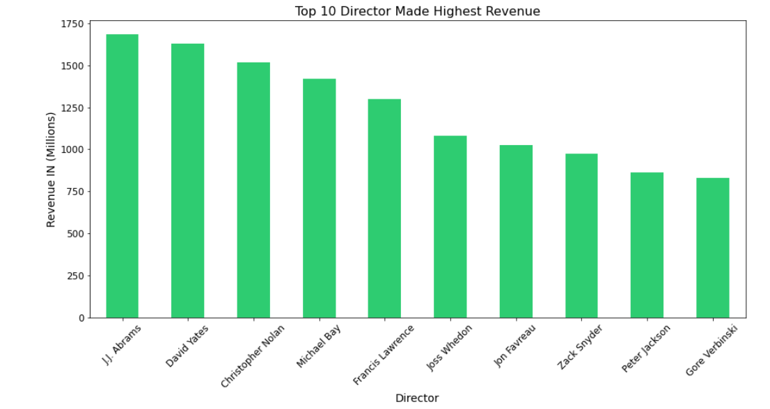
Top 10 Director With highest Revenue

Slide 13
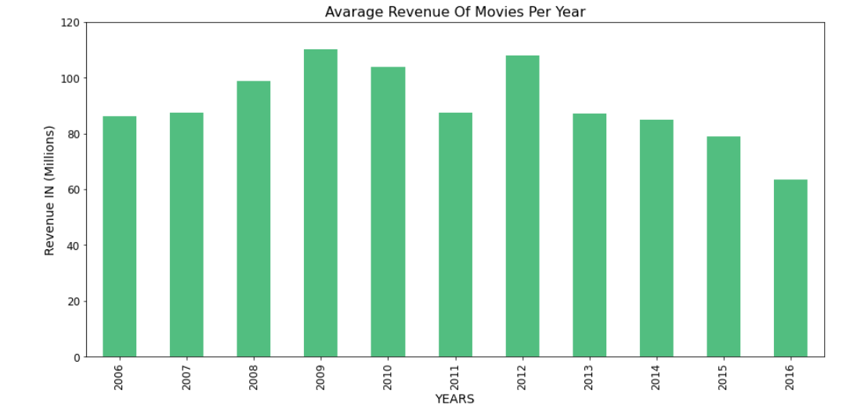
Average Revenue Of Movies Per Year

Slide 14
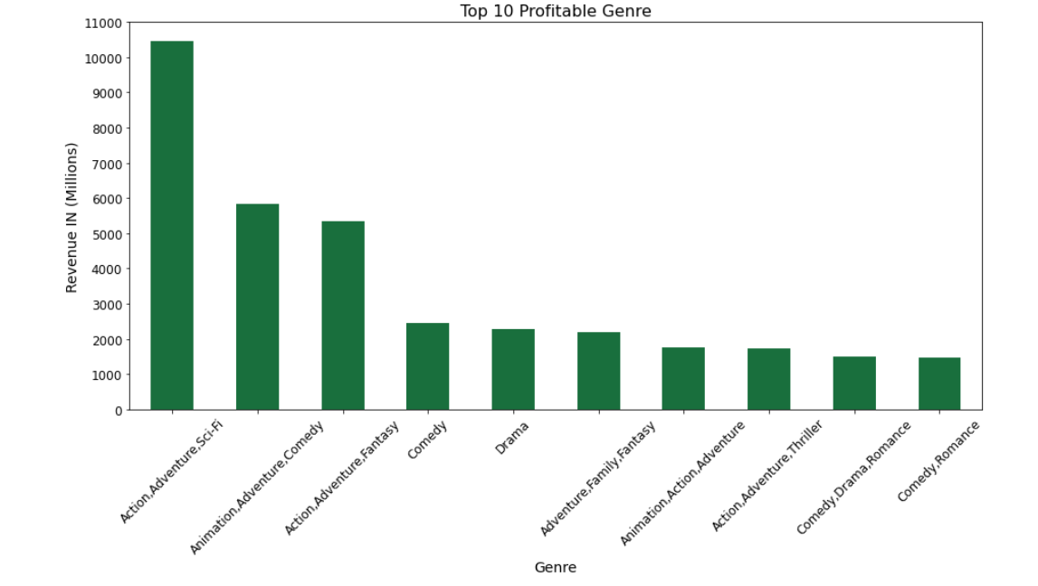
Revenue Generated By Genre Top 10

Slide 15
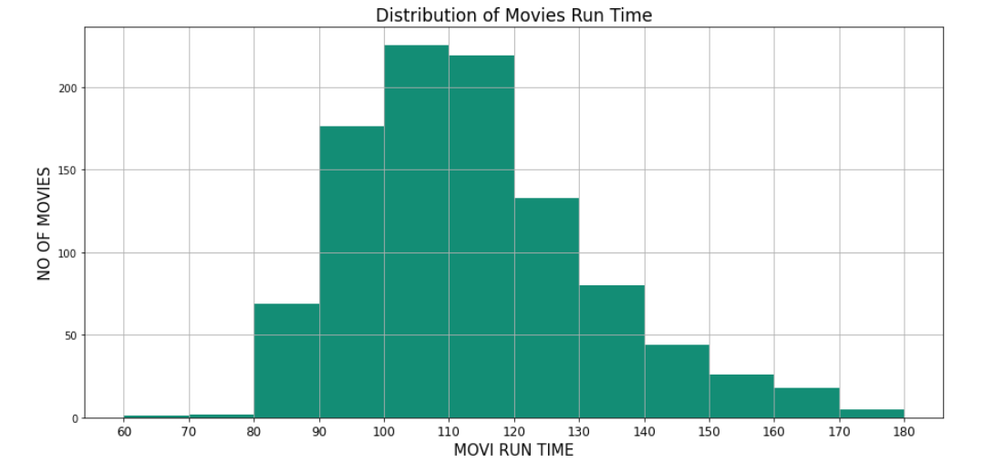
Distribution of Movies Run Time

Slide 16
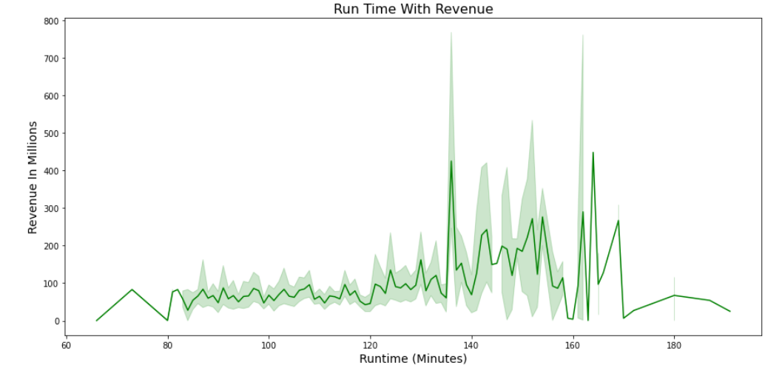
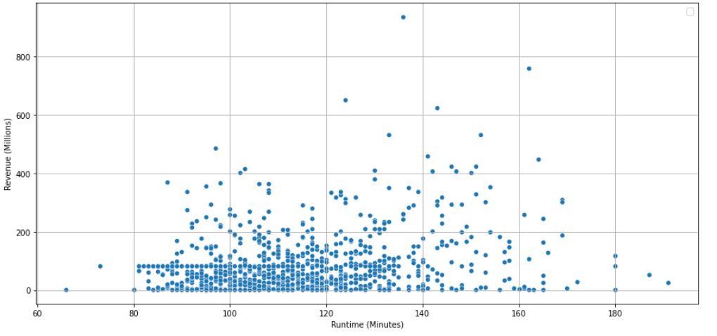
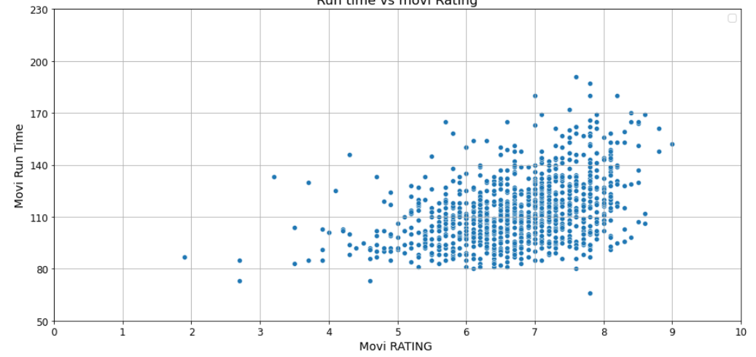
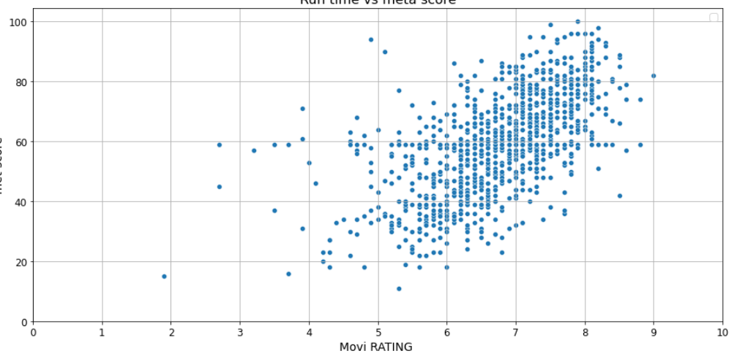
Run Time with Revenue
Run time vs movie Rating
Run time vs meta score

Slide 17
Summarization
2016 produced highest no. of movies, hence got the highest total revenue.
Most movies are from action, adventure, Sci-Fi & drama Genre
Movies that has a duration of approx. 100 to 140 minutes are most favored by audience and critics. Revenue greater than 400 million dollars are the ones with Duration between 120 minutes and 170 minutes.
A director with more number of movies, doesn't mean he/she has generated more revenue.
Most Movies Are From This Following Genre Combination, So They Also Gained The Most Revenue Over The Years"Action, Adventure, Sci-Fi"
Metascore and Rating have positive correlation.

Slide 18
Conclusion
Pick the directors who made high revenues in more than 2 movies.
Make movies in the following genre combinations: 'Animation, Adventure, Comedy' & 'Action, Adventure, Sci-Fi’, Drama as they’ve have gained significantly more revenue than other genre combinations in the latest year.
Duration should be between 120 to 140 minutes.
Votes do play a role in getting better rating and in turn making more
revenue, so the filmmakers should do better promotions.

Slide 19
Thank you
You can connect me on : abhishekrcks1995@gmail.com

